Slide 1
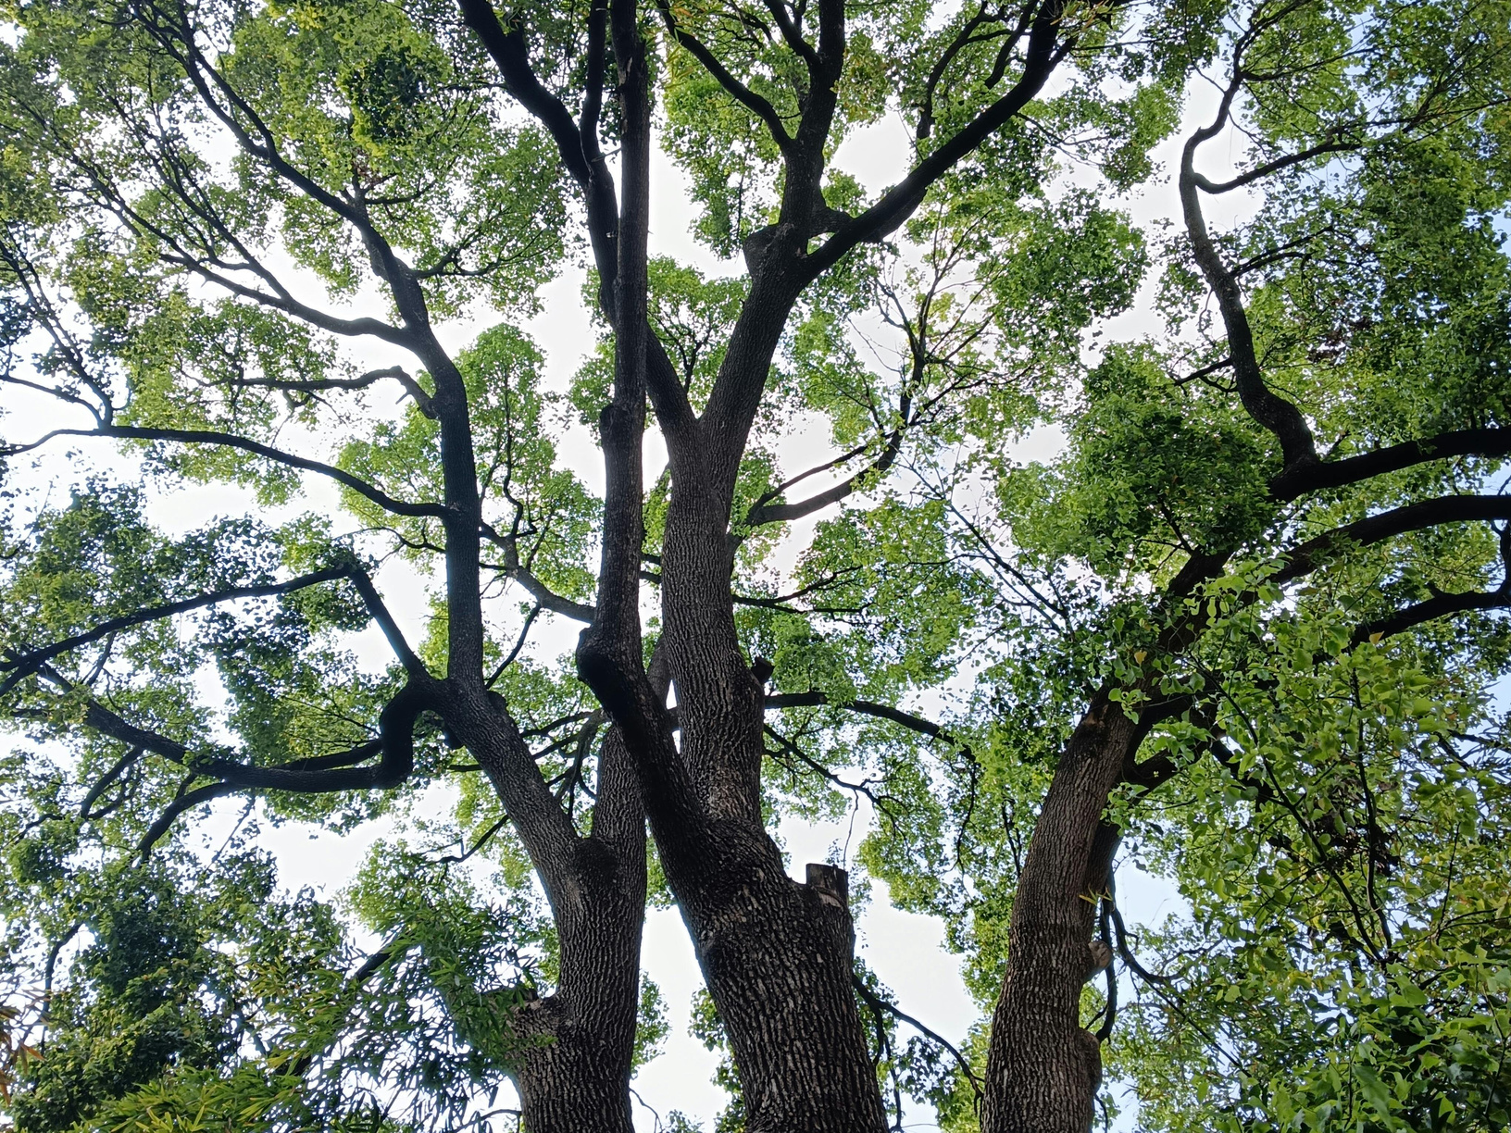
Problem Solving

Slide 2


Problem Solving Agents
A goal-based agent that plans a sequence of actions to achieve its objective.
It operates in search and execution mode:
Formulates the problem
Searches for a sequence of actions that leads to the goal
Executes the resulting plan
Assumes an observable, deterministic, discrete, and static environment.
The solution is always a sequence of actions, not a single action
What Exactly Is the Problem?
What Is the Best Way to Solve It?
Plan Execution

Slide 3

Problem Formulation
Initial State
Define the
State Space
The state from which the agent starts
Actions
The set of actions available in each state
Transition Model
The result of applying an action to a state: Result(s, a) → s'
Goal Test
A condition that determines whether a state is the goal
Cost Function
The numerical cost of each action; it defines solution quality

Slide 4
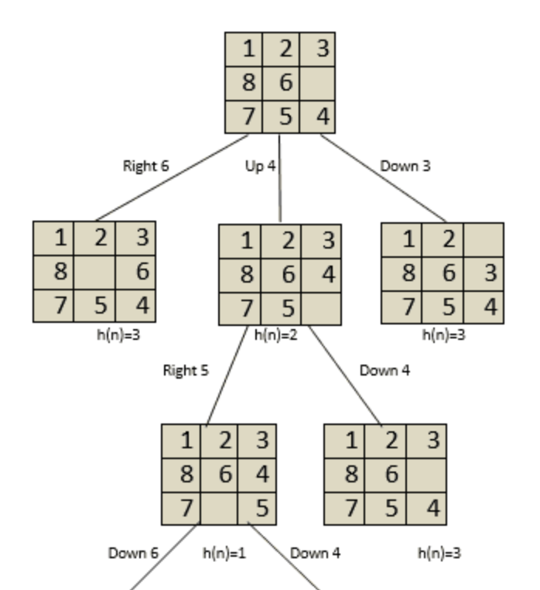
State Space
Initial State
The set of all states reachable from the initial state through any sequence of actions
Represented as a graph in which:
Nodes are states of the world
Edges are actions that transition between states
Each edge has an associated cost
It is not built explicitly because it is too large in practice
The agent explores it progressively during the search
to the goal state

Slide 5
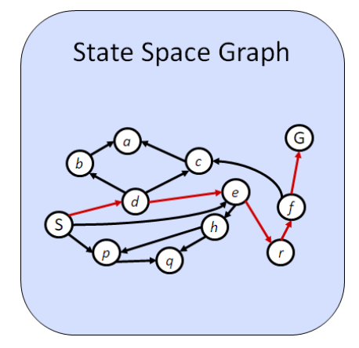
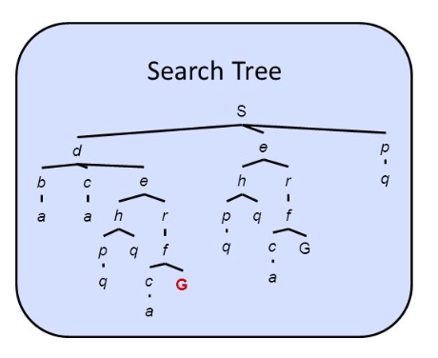
Repeated States
When the search tree is expanded, the same state may be generated through multiple paths, causing infinite cycles if they are not controlled
Solution: maintain two structures during the search
Frontier: states that have been generated but not yet explored
Explored Set: states that have already been expanded and are never generated again
Without repeated-state control, the algorithm may not terminate even when a solution exists.
With control, each state is explored at most once
State Graph
Represents the problem, where each state appears only once
Search Tree
Represents the search process; the same state may appear multiple times when reached through different paths

Slide 6


Uninformed Search
Blind search in which the agent has no additional information about which states are more promising.
It knows only the initial state, available actions, and goal test
It explores the state space systematically without favoring any path
Search algorithms differ in the order in which they expand nodes.
Criteria for evaluating search algorithms:
Completeness: is it guaranteed to find a solution if one exists?
Optimality: is it guaranteed to find the lowest-cost solution?
Time complexity: how long does it take?
Space complexity: how much memory does it require?

Slide 7

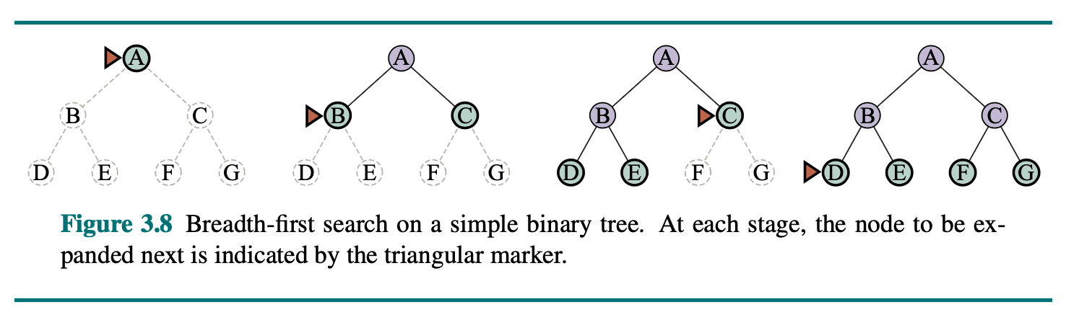
Breadth-First Search (BFS)
Expands the shallowest nodes first, level by level
Data structure: FIFO queue
Properties:
Complete: always finds a solution if one exists
Optimal: finds the path with the fewest steps (when costs are uniform)
Time complexity: O(b^d)
Space complexity: O(b^d)
Memory consumption:
the frontier grows exponentially with depth

Slide 8
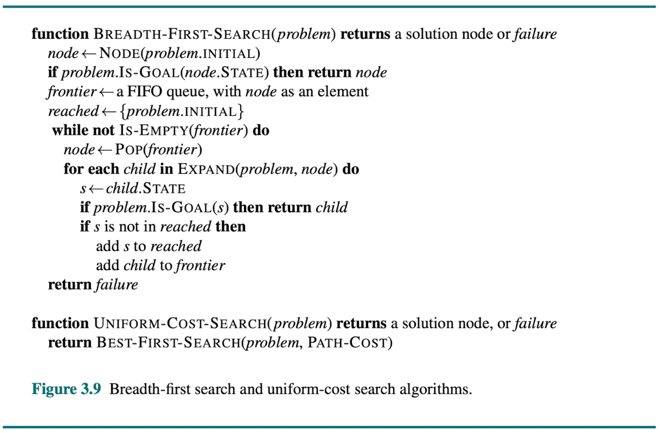

Slide 9

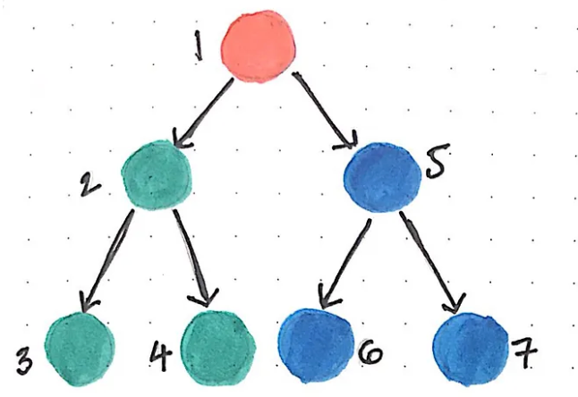
Depth-First Search (DFS)
Low memory use compared with BFS
Expands the deepest nodes first, following one branch to the end
Data structure: LIFO stack
Properties:
Complete: only when repeated states are controlled and the space is finite
Not optimal: does not guarantee the shortest path
Time complexity: O(b^m)
Space complexity: O(b·m)

Slide 10
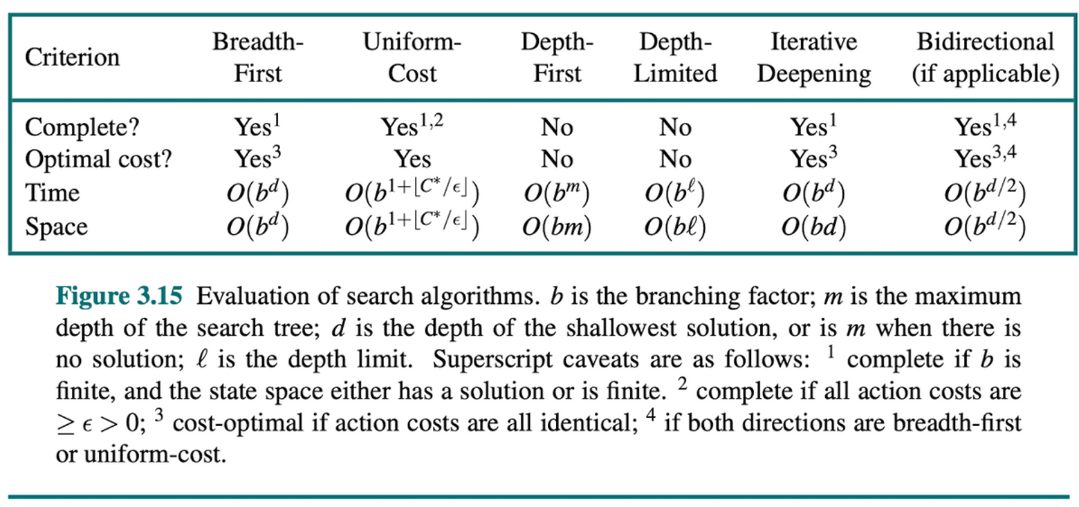

Slide 11

Informed Search
Unlike blind search, it uses additional knowledge about the problem to guide exploration toward the goal
Encodes knowledge in a function
A heuristic does not guarantee the correct path; it is an estimate
A good heuristic dramatically reduces the number of nodes explored
h(n) = estimated cost from node n to the goal
h(n) = 0 if n is the goal node
h(n) ≥ 0 always
Heuristic

Slide 12
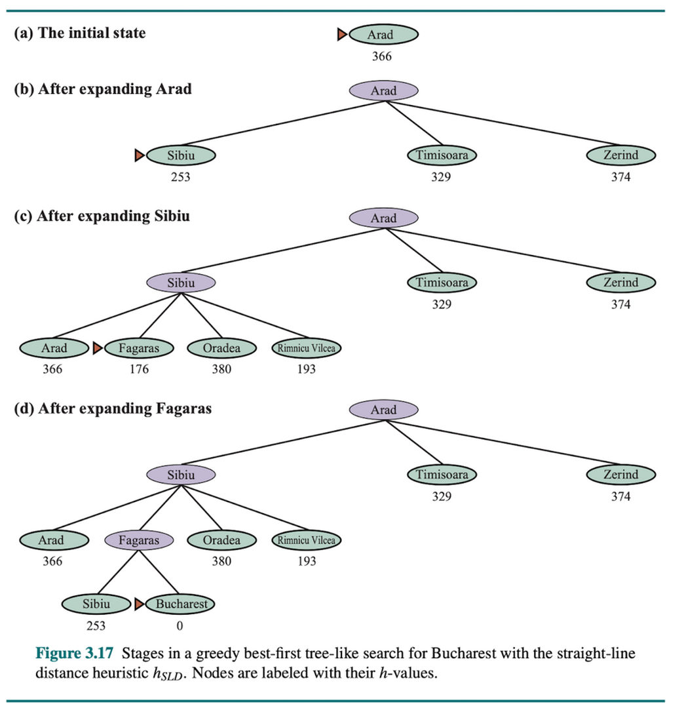
Best-First Search
Always expands the node that appears closest to the goal according to h(n)
Data structure: priority queue ordered by h(n)
It is greedy—it makes the locally optimal decision at each step without considering accumulated cost
Properties:
Complete: only when repeated states are controlled
Not optimal: does not guarantee the lowest-cost path
It may become trapped in suboptimal paths when the heuristic is misleading

Slide 13
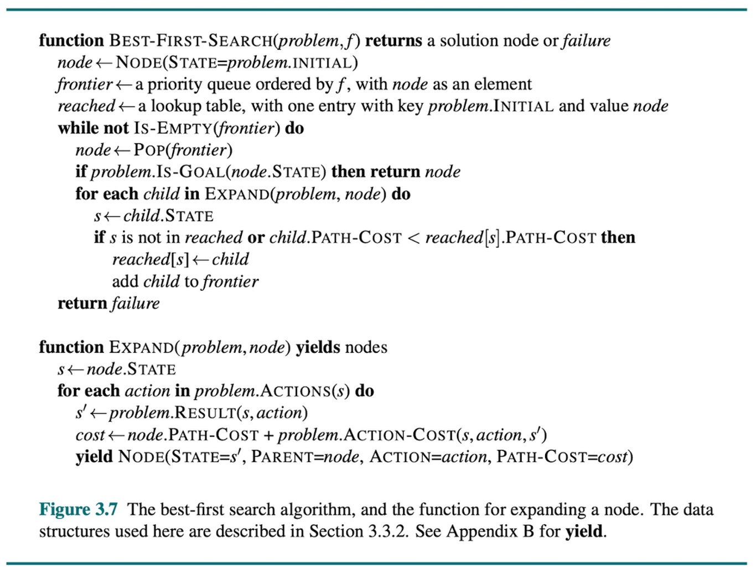

Slide 14


A*
Always expands the node with the lowest f(n)
Data structure: priority queue ordered by f(n)
Intuition: it considers not only what appears close to the goal (h), but also the best estimated total cost (h + g)
g(n) — actual accumulated cost from the start to n
h(n) — heuristic estimate of the lowest cost from n to the goal.
f(n) = g(n) + h(n) — estimated total cost of the path through n
Properties:
Complete: always finds a solution if one exists and h is admissible
Optimal: guarantees the lowest-cost path if h is admissible/consistent
Space complexity: O(b^d); stores every node in memory
Time complexity: depends on the quality of h(n)

Slide 15
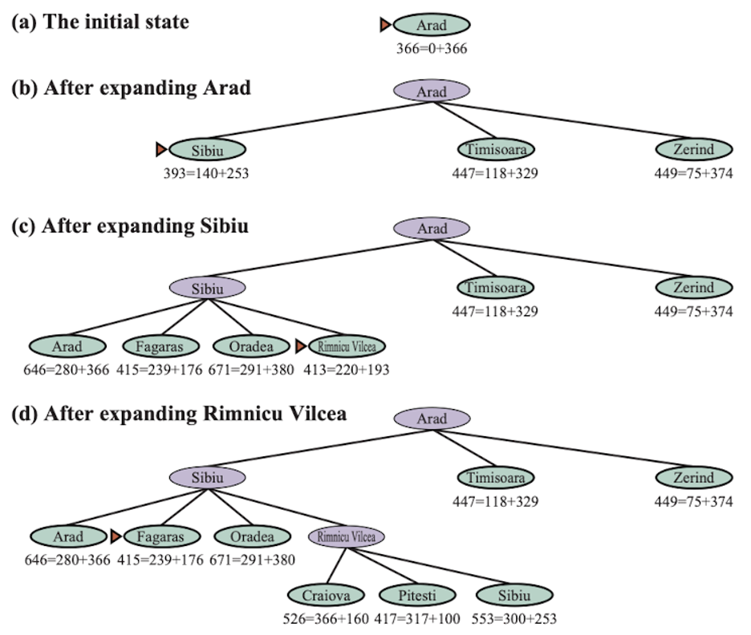
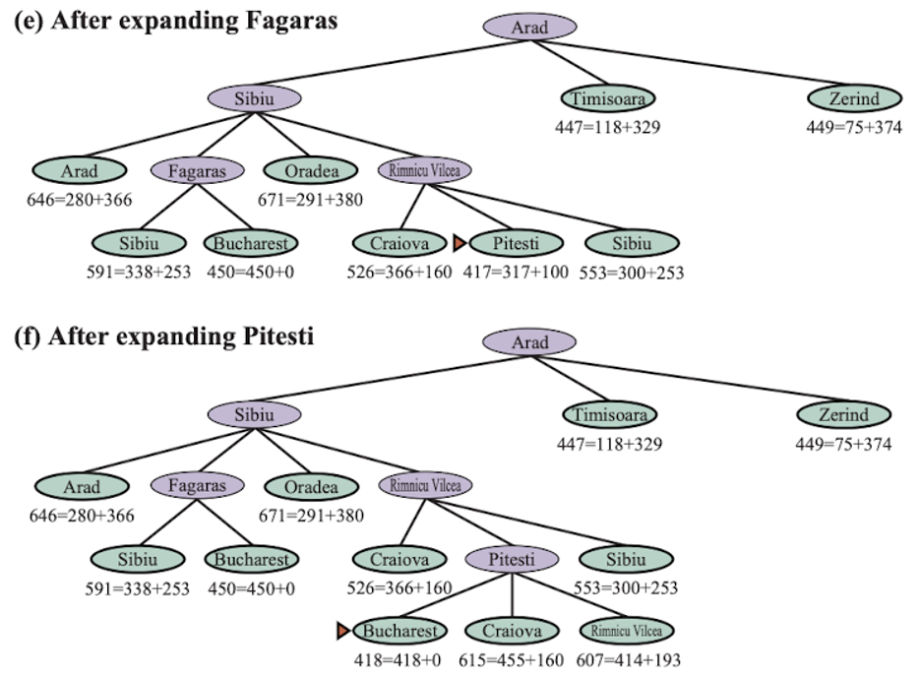

Slide 16
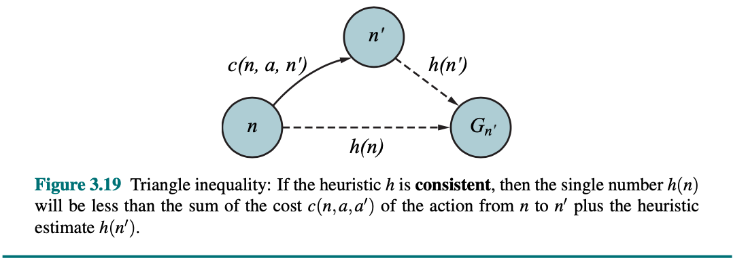
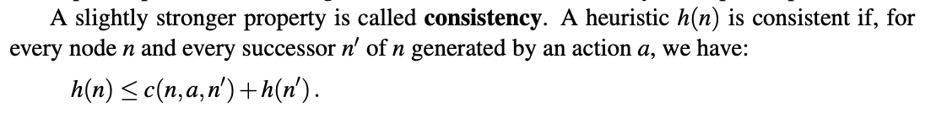
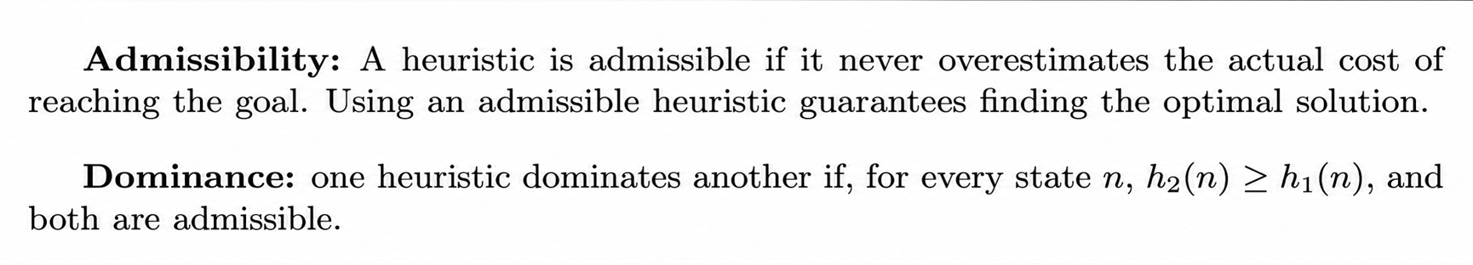
Properties of
Heuristics

Slide 17

Adversarial Search and Games
So far: one agent searching for a solution in a cooperative or neutral environment
In games: two or more agents with opposing objectives.
The problem is no longer finding a path to the goal; it is finding the optimal strategy while considering that the opponent also plays optimally
Two players: MAX and MIN
One player’s gain is the other player’s loss
Perfect information: a fully observable environment
Deterministic: no randomness

Slide 18

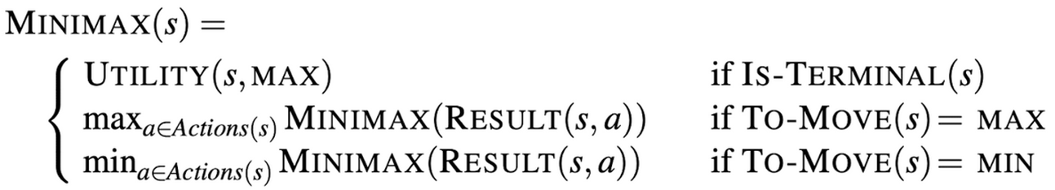
Minimax
MAX attempts to maximize the value of the final state
MIN attempts to minimize that same value
Assumes both players play optimally
Time complexity: O(b^m)
Space complexity: O(b·m)
Explores the complete tree down to terminal nodes
The Minimax value of a node is defined recursively:
If it is a terminal node: Utility(s), the actual value of the outcome
If it is MAX’s turn: the maximum Minimax value among the successors
If it is MIN’s turn: the minimum Minimax value among the successors

Slide 19
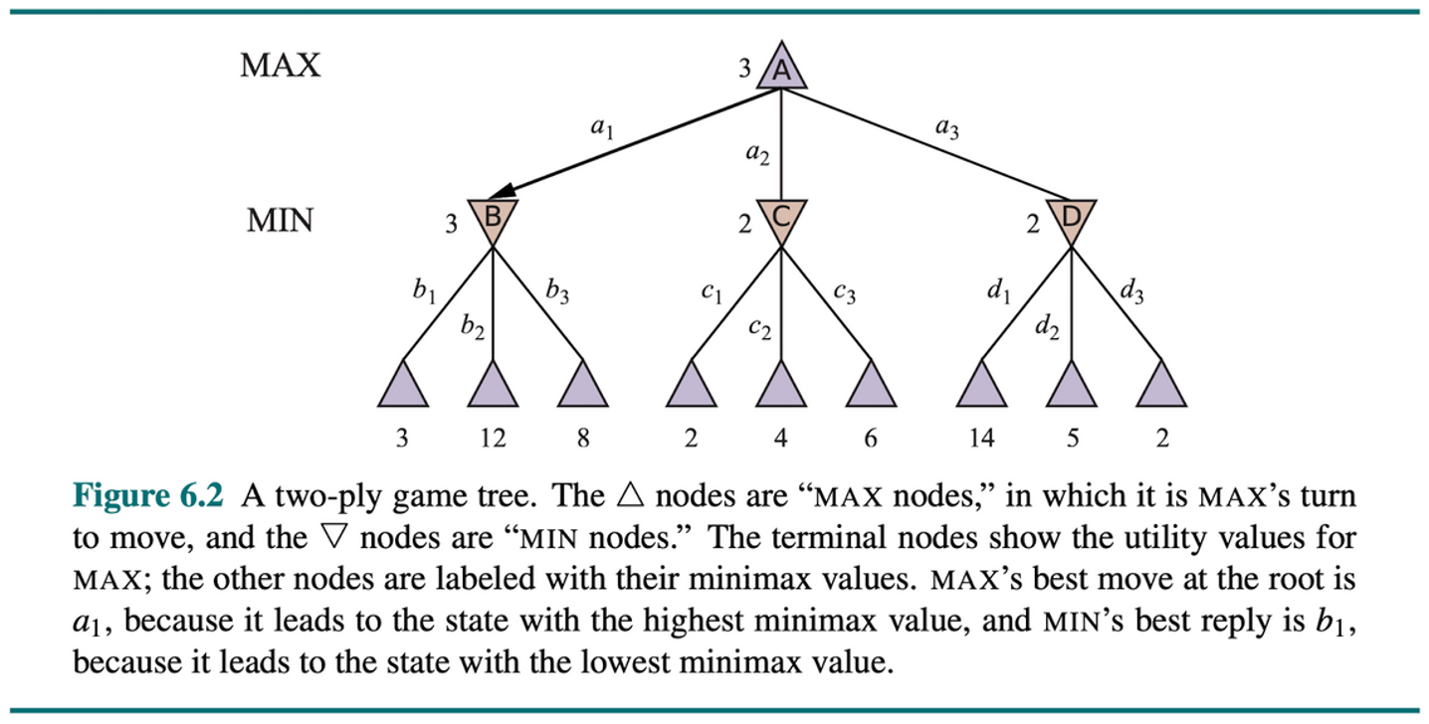

Slide 20

Alpha–Beta Pruning
Minimax explores the entire tree but is inefficient for real games
Alpha–Beta eliminates branches that cannot influence the final decision
It finds the same solution as Minimax while exploring far fewer nodes
Optimal complexity: O(b^(m/2))
Pruning rule:
If the value at a MIN node falls below α
→ prune (MAX would never choose this path)
If the value at a MAX node rises above β
→ prune (MIN would never choose this path)
α: best value found so far for MAX (lower bound)
β: best value found so far for MIN (upper bound)

Slide 21
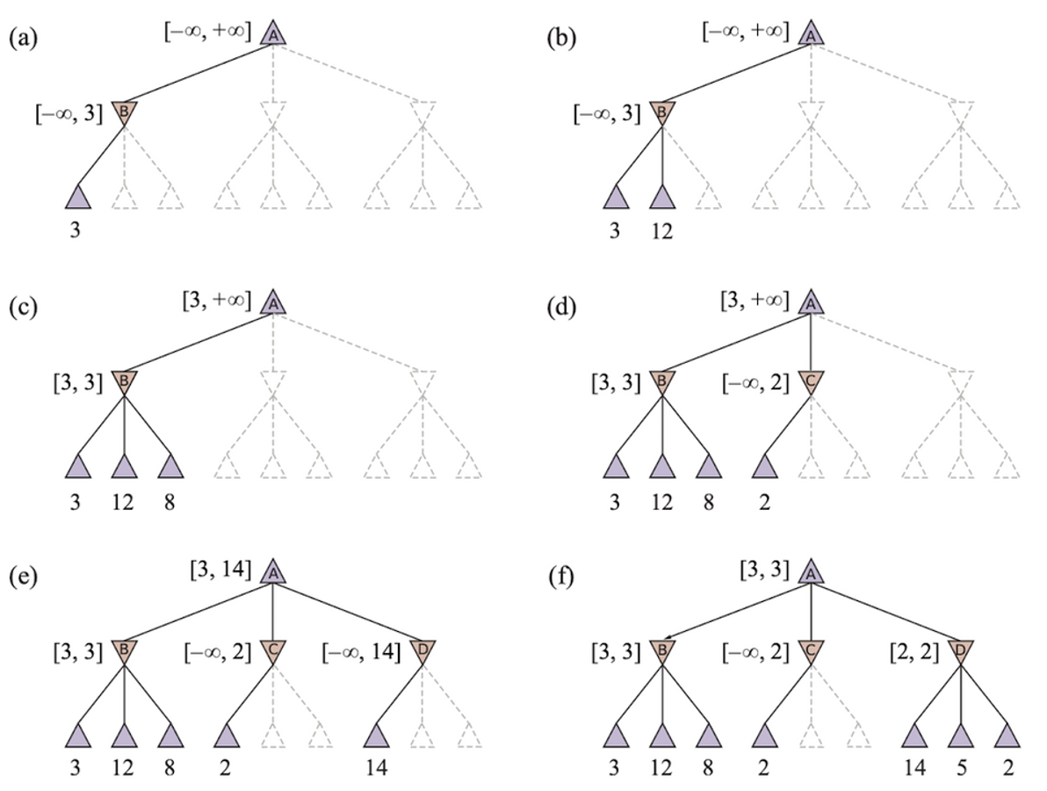

Slide 22
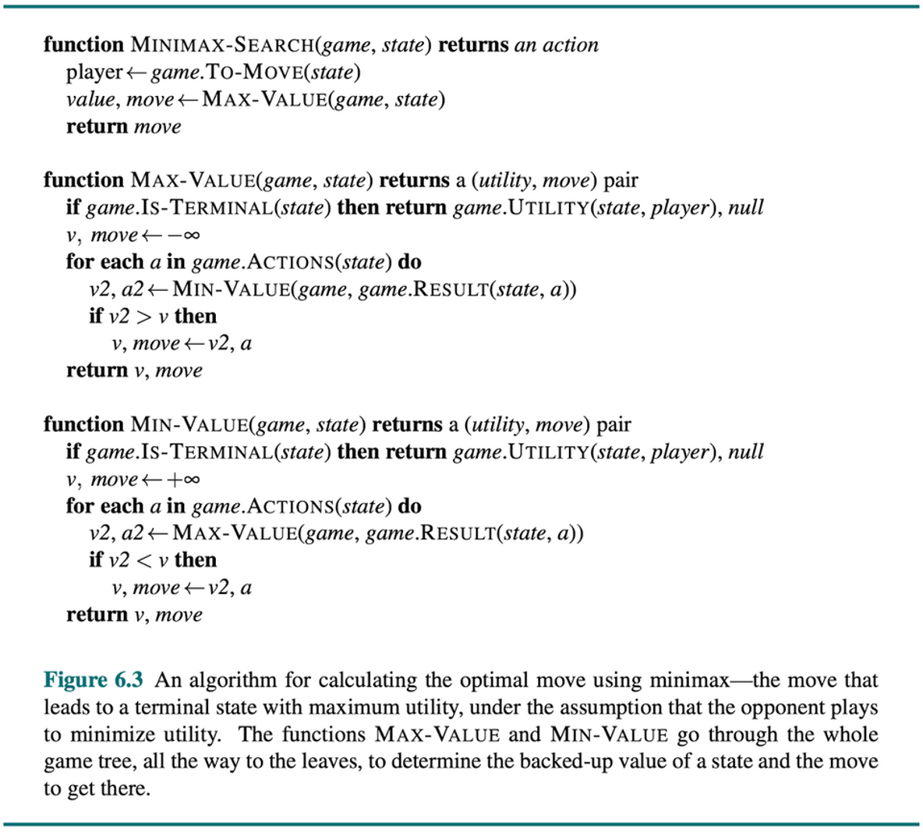

Slide 23

Constraint Satisfaction Problems
Sudoku
Constraint — numbers cannot repeat in rows, columns, or boxes
In standard search, states are black boxes; only reaching the goal matters
In a CSP, states have internal structure: variables with values that must satisfy constraints
A CSP is solved when a complete and consistent assignment of values to all variables is found
School schedule
Constraint — sports cannot be scheduled after lunch

Slide 24
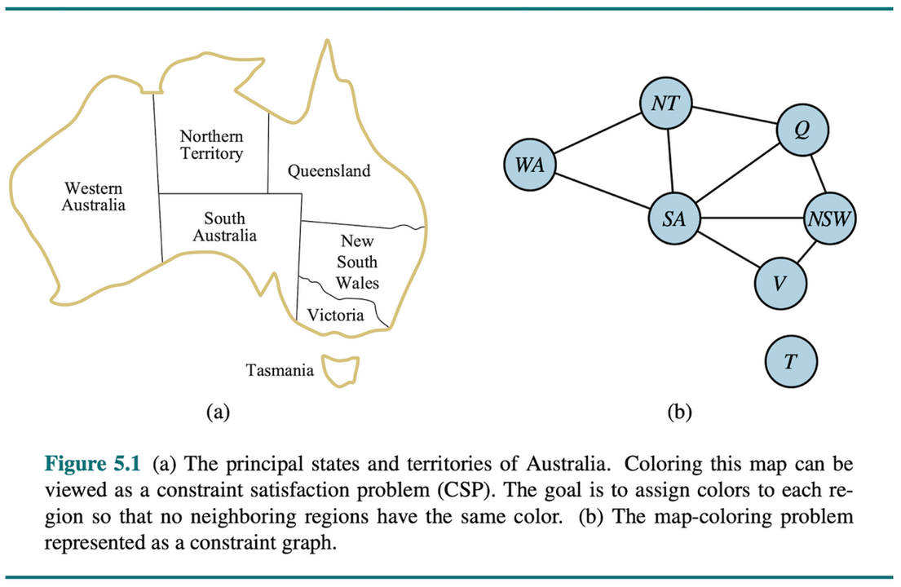
CSP Components
Variables: X = {X₁, X₂, ..., Xₙ} — what must be assigned
Domains: D = {D₁, D₂, ..., Dₙ} — possible values for each variable
Constraints: C = the set of conditions that assignments must satisfy
A consistent assignment violates no constraints
A complete assignment gives every variable a value
Constraint propagation: domains can be reduced before assignment
Forward Checking
Arc Consistency
Minimum Remaining Values

Slide 25
